Slide 1
Style-GANs
Week 11: (4/21/2022) Team Lead: Christian Zamiela
Notes:
Introduce ourself, what we do and the department

Slide 2
Recap: Conditional GANS
cGANs have TWO main advantages over traditional GANs
Improve the overall GAN model
Targeted Image Generation
To start, by incorporating this additional information, cGAN provide several improvements:
More Stable Training
Faster Training and Convergence
Higher Quality Images
In addition, these class labels allow for targeted image generation, given a specific conditioning value, which is extremely useful in a variety of applications
Image to Image Translation
Targeted Image generation
Video Generation
Unbalanced Data Generation (If enough samples to learn distribution)

Slide 3
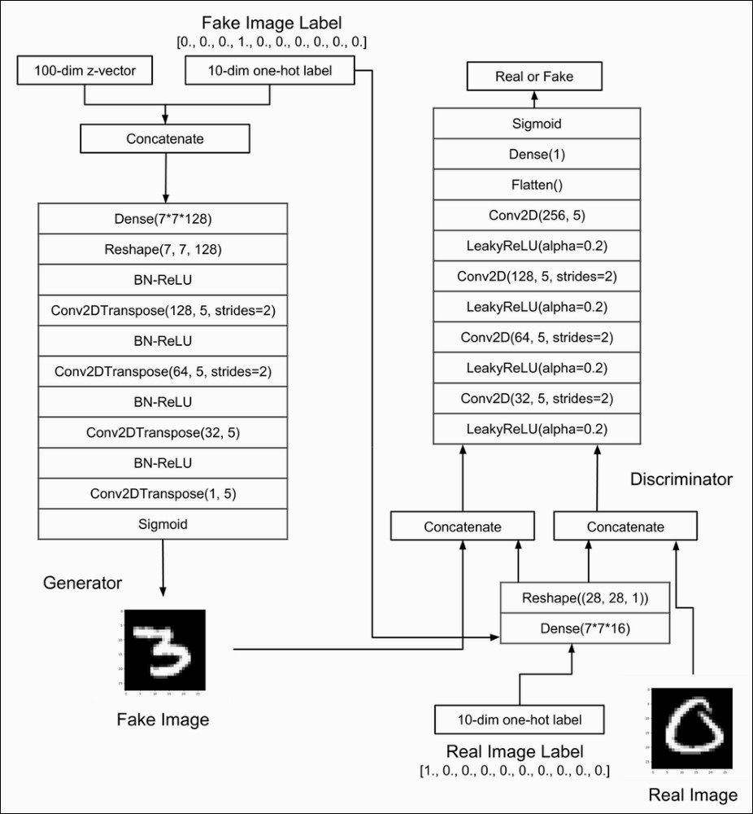
Original Data
X
Real Images
x|y
DISCRIMINATOR
y
Class
Labels
z|y
Latent
Space
l|y
GENERATOR
Fake Images

Slide 4
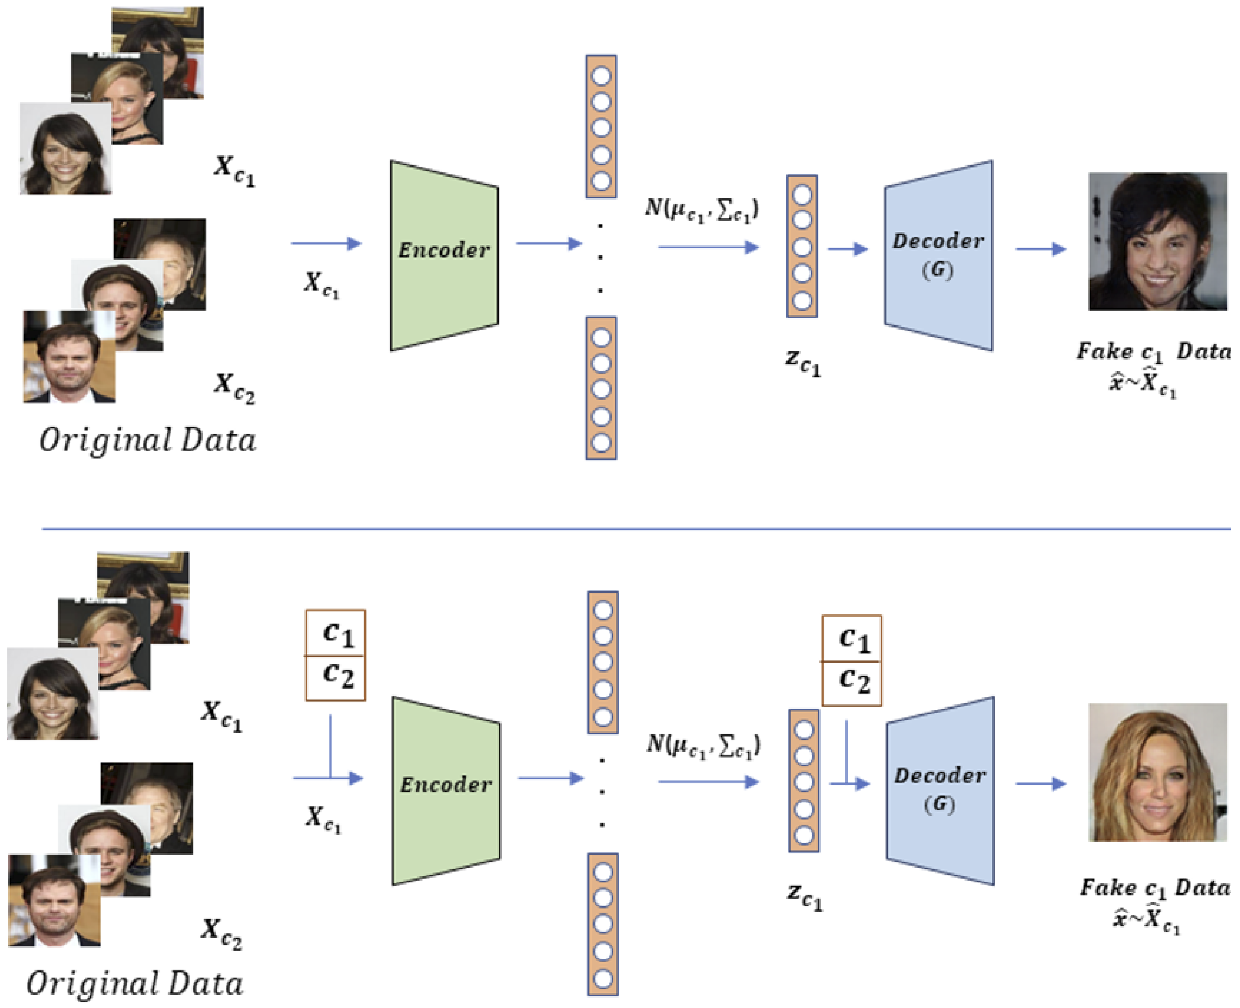
Ghosting
Distortion
Noise
*Genderless
Higher Quality
Specific Gender (c)

Slide 5
Style-GAN Content
Objective of Style-GANs
Technical Contributions
Style-GAN Mapping Network
ProGAN Network To Coarse Features
AdaIN (Adaptive Instance Normalization)
Reduced Feature Entanglement
Limitation of Style-GAN
Additional Style-GAN Developments
Proposed Style-GAN Model for Additive Manufacturing

Slide 6
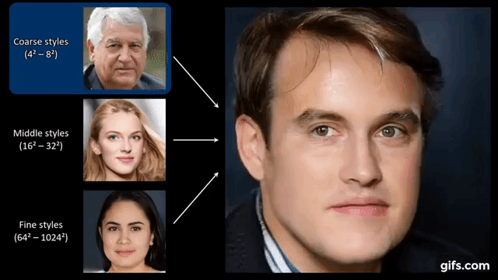
Style-GANs
Objective: Generate artificial image gradually to a higher resolution with limited training samples.
Combines multiple images to create a realistic image that reflects properties from each image.
By modifying the input of each level separately, it controls the visual features that are expressed in that level.

Slide 7
Style-GAN
Technical Challenge
While GAN images became more realistic over time, one of their main challenges is controlling their output, i.e. changing specific features such pose, face shape and hair style in an image of a face.
Unbalanced datasets leads to common features holding more value than other less common features
Technical Contribution
An extension to the GAN architecture that proposes large changes to the generator model, including the use of a mapping network to map points in latent space to an intermediate latent space.
The use of the intermediate latent space to control style at each point in the generator model, and the introduction to noise as a source of variation at each point in the generator model.
Notes:
For example, if images of people with black hair are more common in the dataset, then more input values will be mapped to that feature. As a result, the model isn’t capable of mapping parts of the input (elements in the vector) to features, a phenomenon called features entanglement.

Slide 8
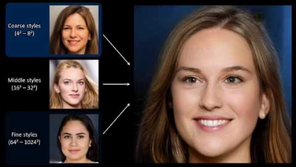

Slide 9
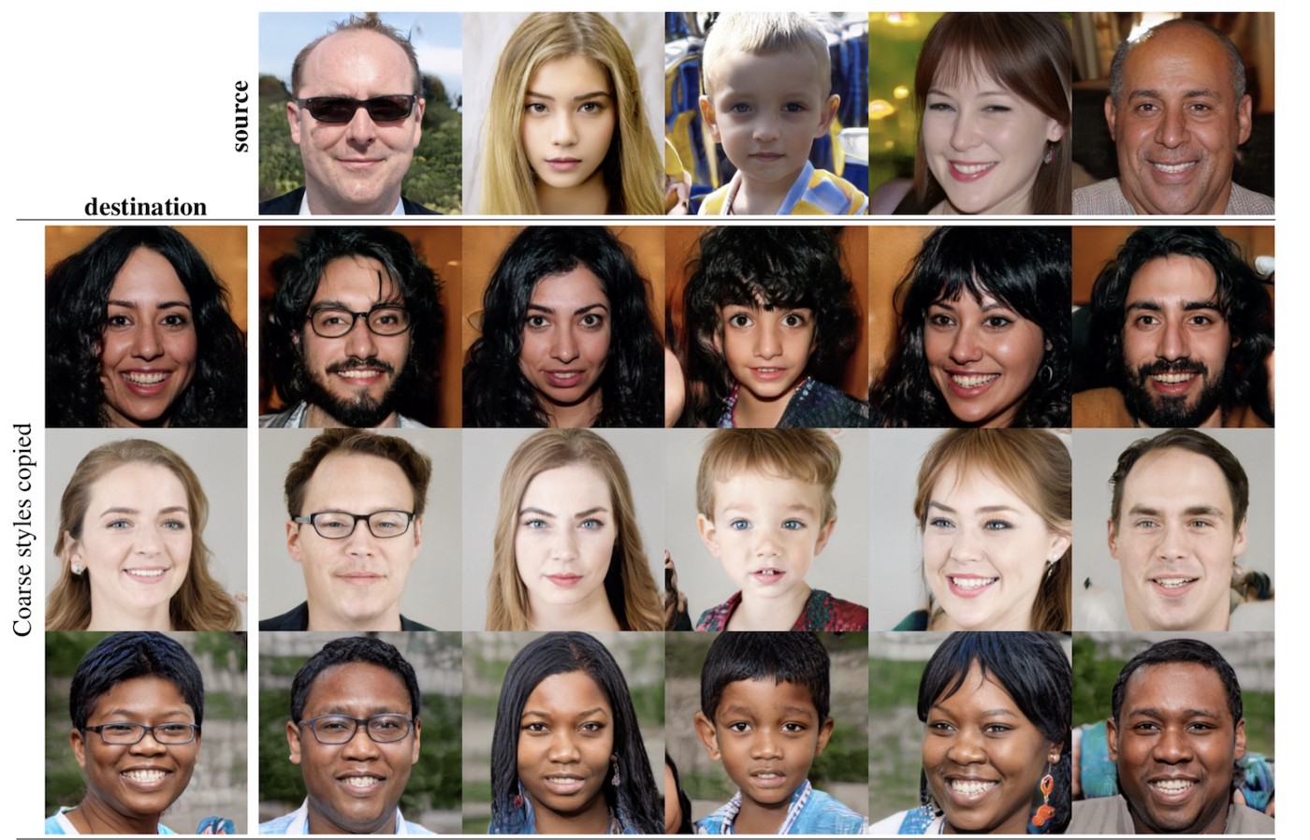
Human Face Style-GAN

Slide 10
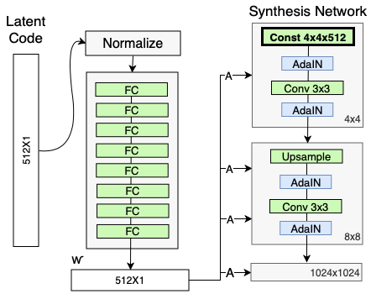
Style-GAN Mapping
The Novel Mapping Network’s goal is to use an intermediate vector whose different elements control different visual features.
Traditional GAN models input vector is limited, as it must follow the probability density of the training data. (Need a balanced dataset).
Using another neural network model can generate weight W that do not have to follow the training data distribution and can reduce the correlation between features.
Notes:
encode the input vector into
This is a non-trivial process since the ability to control visual features with

Slide 11
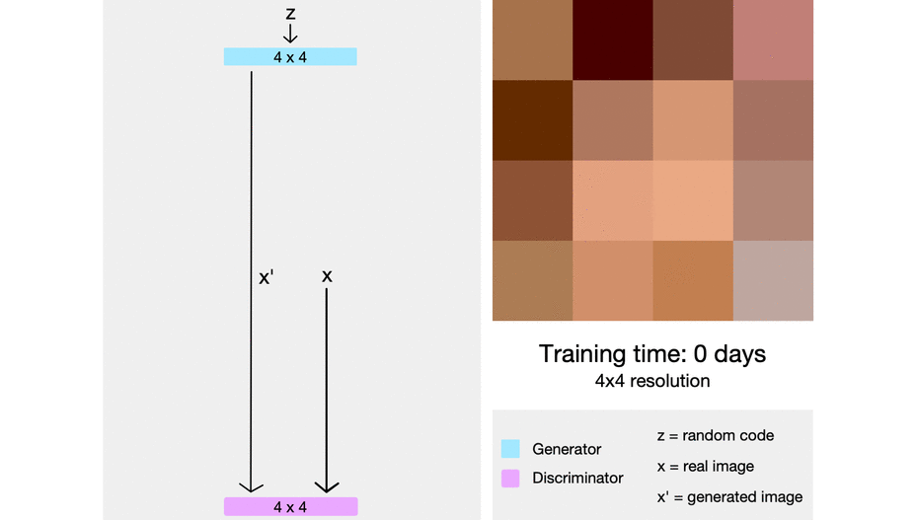
ProGAN Network To Coarse Features
Coarse - resolution of up to 82 - affects pose, general hair style, face shape
Middle - resolution of 162 to 322 - affects finer facial features, hair style, eyes open/closed.
Fine - resolution of 642 to 10242 - affects color scheme (eye, hair and skin) and micro features.

Slide 12
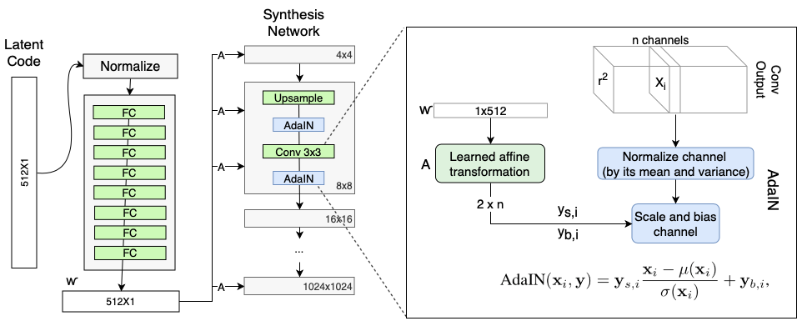
AdaIN (Adaptive Instance Normalization)
Transfers the encoded information ⱳ at each resolution level, created by the Mapping Network, into the generated image synthesis network.
Each channel of the convolution layer output is first normalized to make sure the scaling and shifting have the expected effect.
The intermediate vector ⱳ is transformed using another fully-connected layer (marked as A) into a scale and bias for each channel.
The scale and bias vectors shift each channel of the convolution output, thereby defining the importance of each filter in the convolution. This tuning translates the information from ⱳ to a visual representation.

Slide 13
Reduced feature entanglement
Feature entanglement occurs when using an unbalanced dataset.
Most models, and ProGAN among them, use the random input to create the initial image of the generator (i.e. the input of the 4×4 level).
StyleGAN controls features by ⱳ and the AdaIN, and therefore the initial input can be omitted and replaced by constant values.

Slide 14
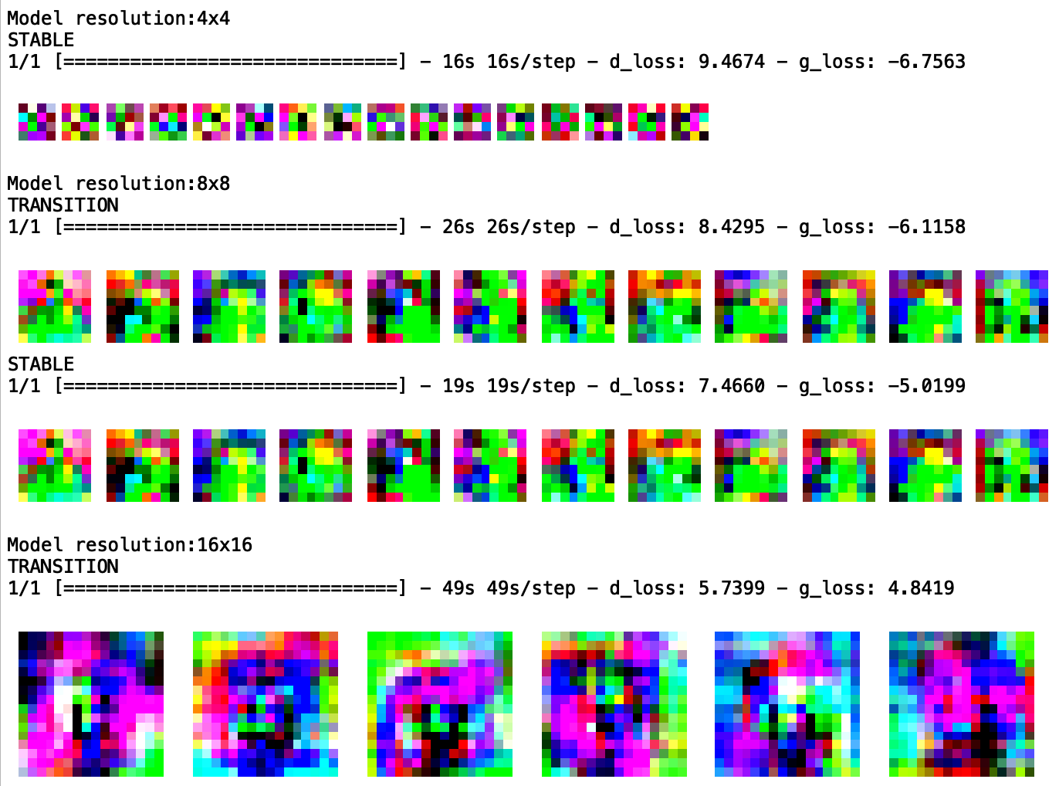
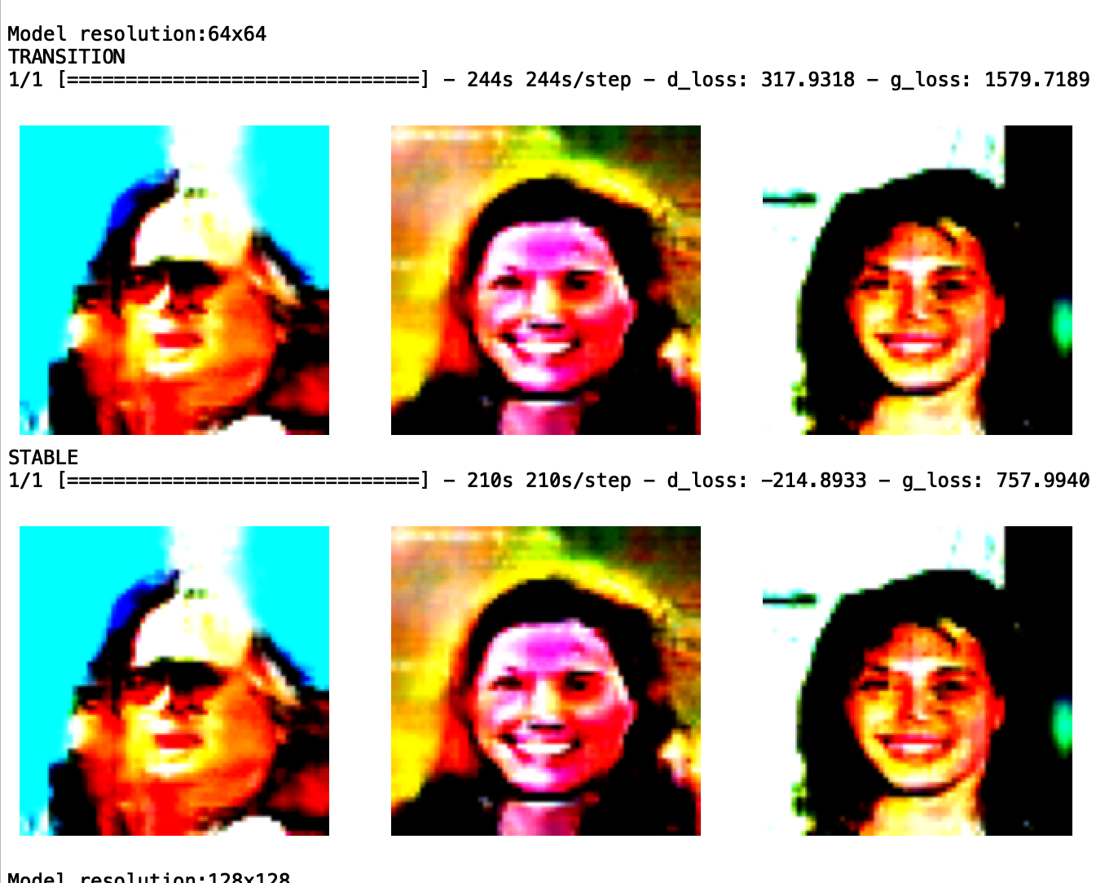
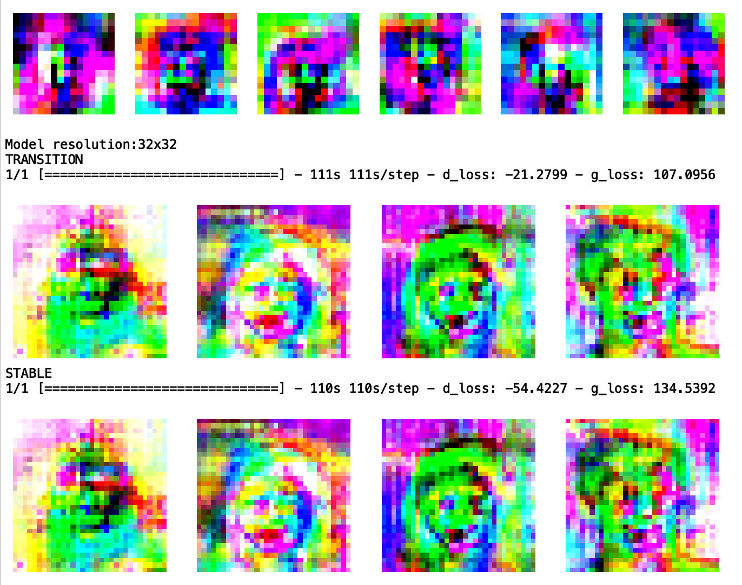
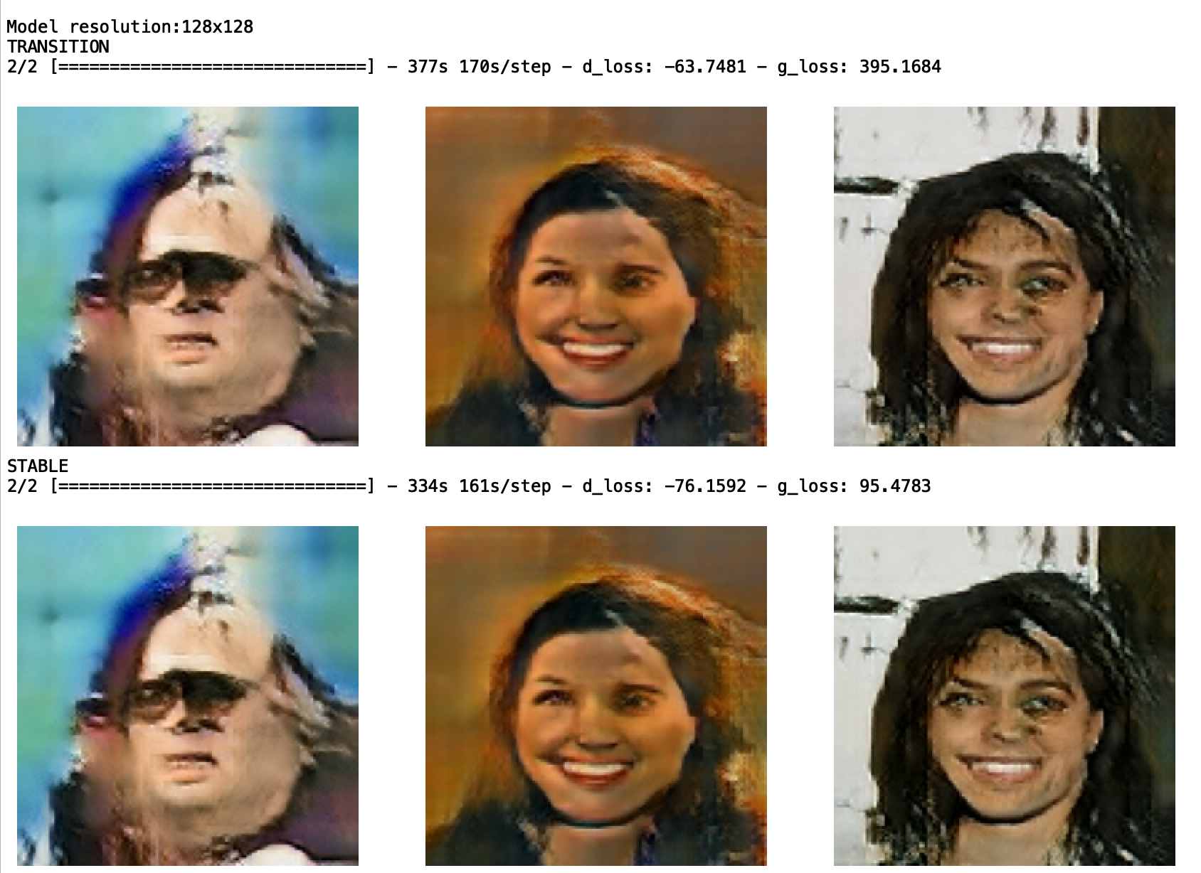
Keras
Python Example

Slide 15
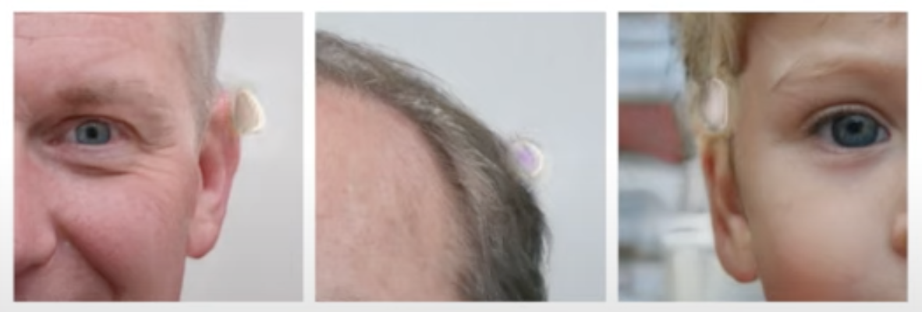
Limitation of Style-GAN
Water splotches: Shiny blobs that are a give away for generated image detection models.
Phase Artifacts: Unrealistic or uneven features within the generated image that are dissimilar from other features.

Slide 16
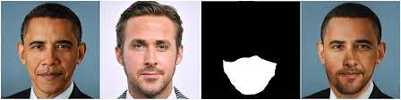
Additional Style-GAN Developments
Style-GAN2
The author employs weight demodulation and removing progressive growing to prevent water splotches and phase artifacts.
Images in Style-GAN have a strong location preference for facial image features like noses and eyes. The authors attribute this to progressive growing.
Image2Style-GAN++
Embed segmentation images into latent space of Style-GAN for localized control over editing operations.
Employs activation tensor manipulations
to guide the model to locations to interpolate.

Slide 17
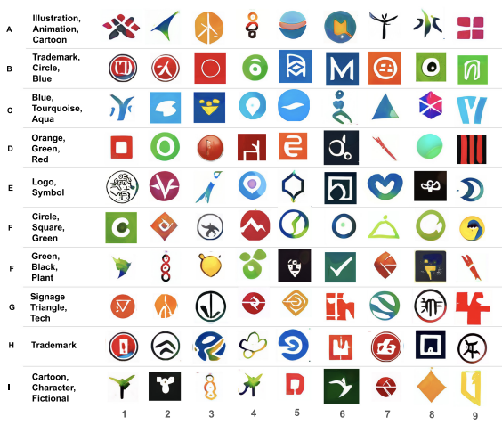
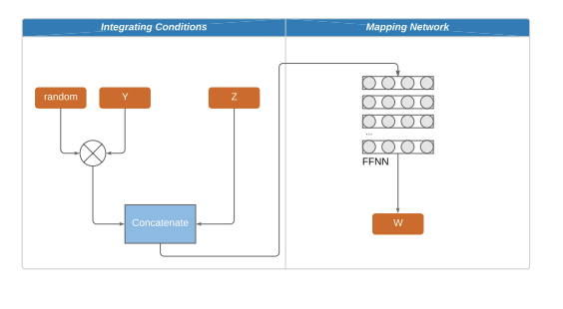
Additional Style-GAN Developments
LoGAN
Combines cGAN and Style-GAN models to conditional produce logos with specific features.
Challenge with this dataset is virtual characteristic are hard to define in logos.

Slide 18
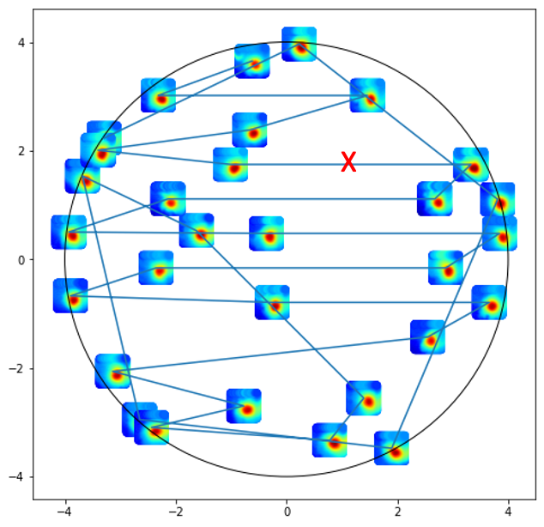
Employing GANs in Additive Manufacturing to Fill Missing Data
The objective is to employ Generative Adversary Networks (GANS) to fill missing thermal sensor data locations for Additive Manufacturing.
Advantages of In-situ Thermal Imaging:
Monitor the quality of part.
Detect abnormalities not easily seen from the outer
layer.
Key Challenges: (1) Limiting capturing area
(2) Limiting capturing speed
Notes:
Need to create a surrgogate model for thermal information to better understand thermal properities that lead to

Slide 19
Purpose
There is a need for a thermal surrogate method that can reflect thermal properties throughout the additively manufactured part.
Technical Challenges:
Developing a melt pool image that reflects what nearby melt pool images are doing on the same fabrication track.
Creating a Generator of melt pool images that accurately reflects the printing direction.
Technical Contribution:
Combine melt pool thermal images using style-gan mapping network..
Train a combined style and conditional GAN to generate a melt pool images with a conditional print direction and abnormality labels and transfer the style to the combined melt pool thermal images.
Notes:
After reviewing literature the technical challenges of creating a versatile method for combining distinctly..

Slide 20
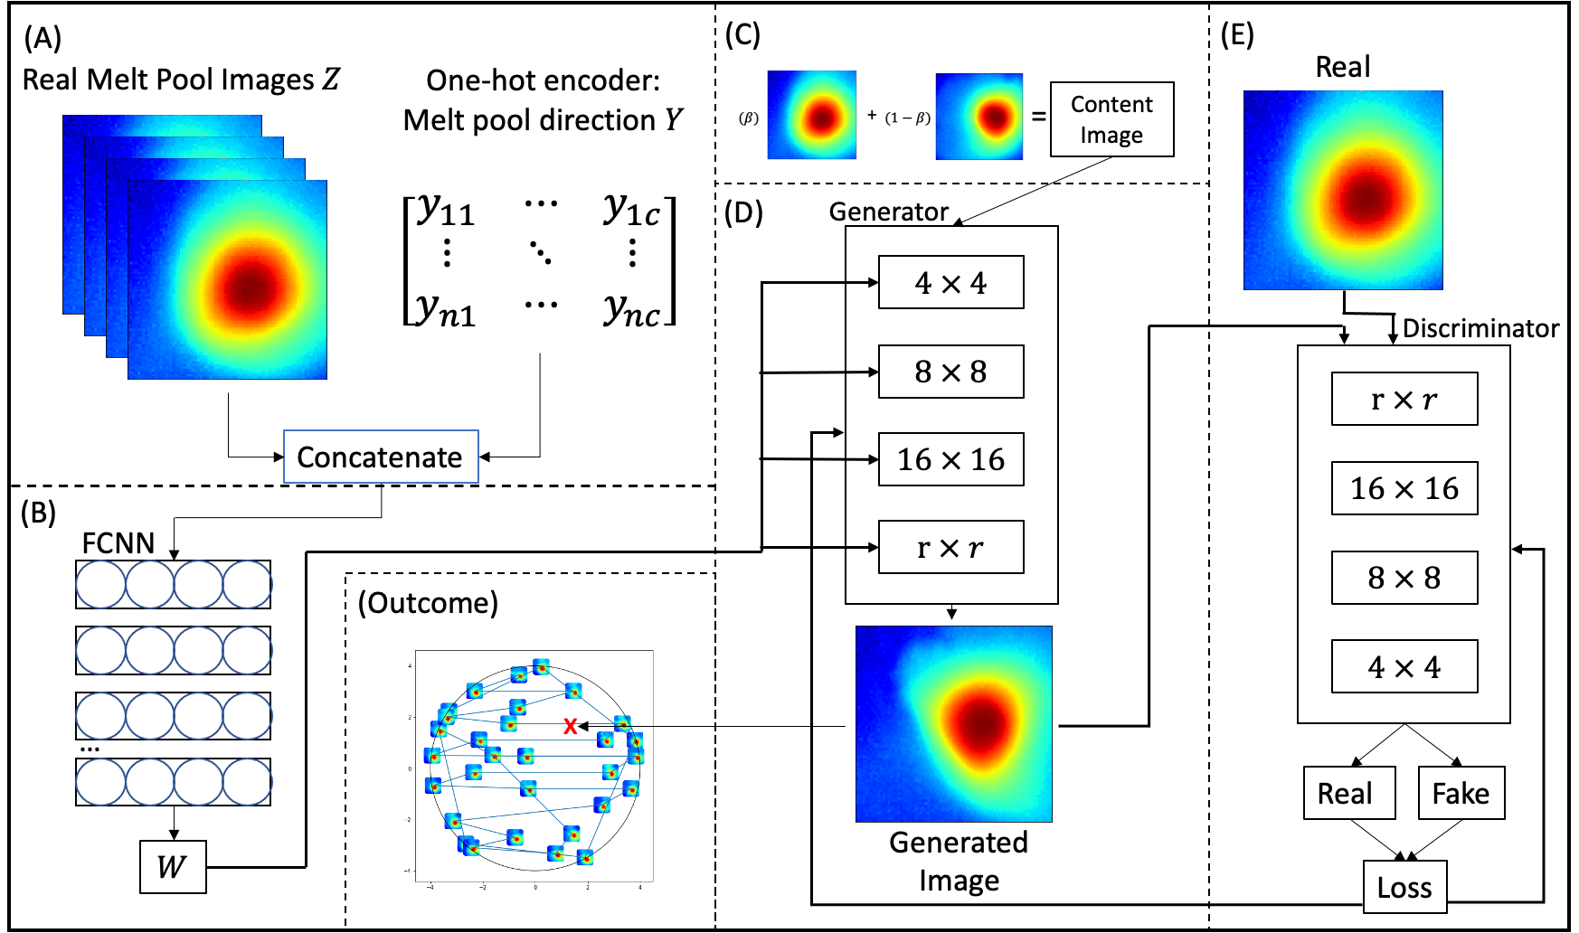
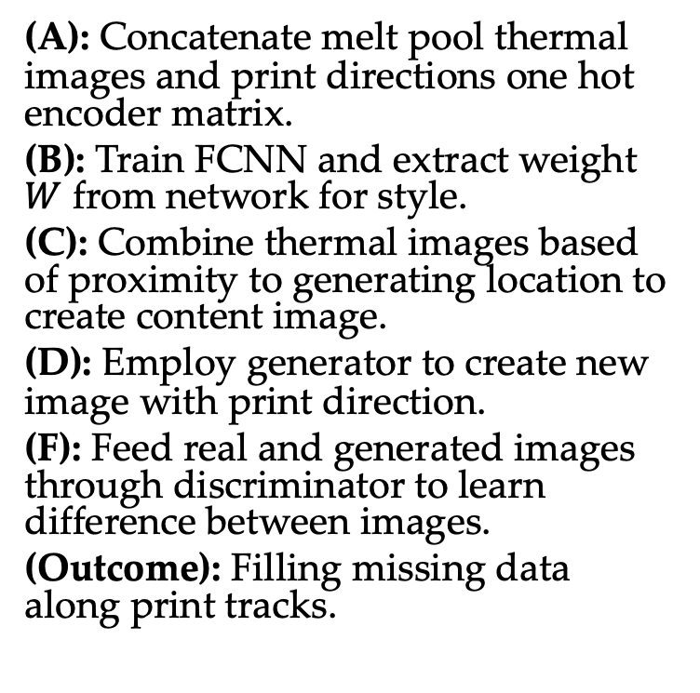
Generative Adversarial Network Methodology For Filling Missing Data
(A): Concatenate melt pool thermal images and print directions one hot encoder matrix.
(B): Train FCNN and extract weight $W$ from network for style.
(C): Combine thermal images based of proximity to generating location to create content image.
(D): Employ generator to create new image with print direction.
(F): Feed real and generated images through discriminator to learn difference between images.
(Outcome): Filling missing data along print tracks.

Slide 21
Summarize
Style-GAN produces high-quality and realistic images but also allows for superior control and understanding of generated images
The key contribution of StyleGAN is the mapping network that combines weights through ProGAN generator with Adaptive Normalization (AdaIN).
A combined cGAN and Style-GAN structure methodology has the potential to combine melt pool images while controlling specific features properties.

Slide 22
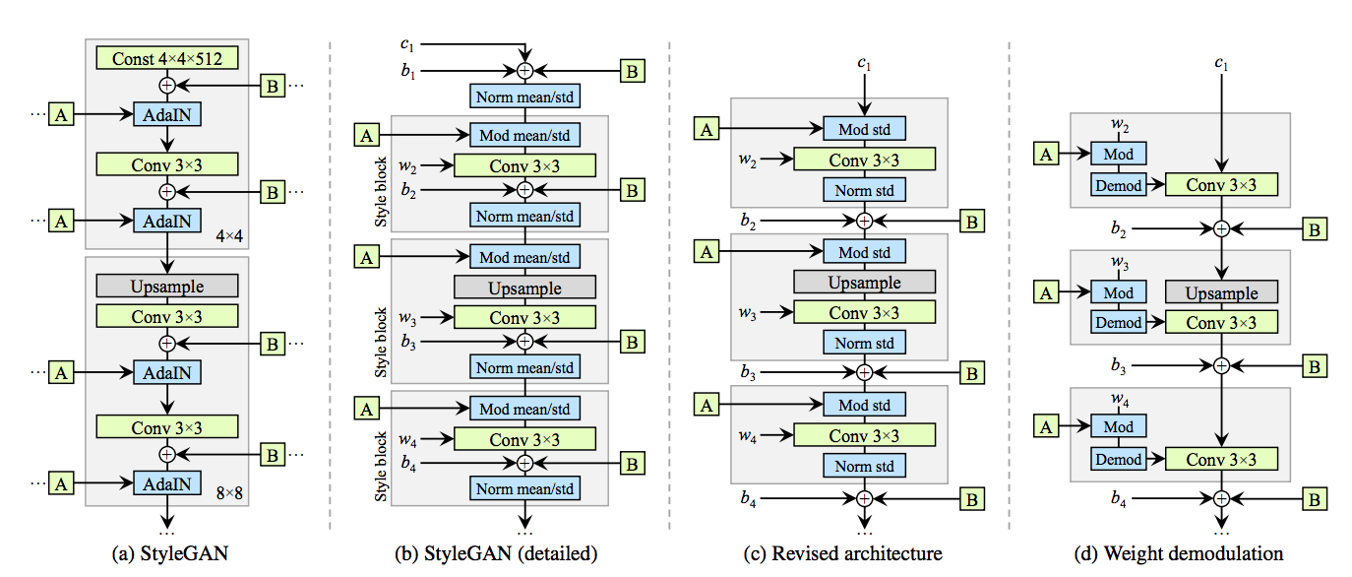
Weight demodulation
Adaptive Instance Normalization scales and shifts the activations of intermediate activations.
Weight demodulation takes the scale and shift parameters out of a sequential computation path, instead baking scaling into the parameters of convolutional layers.

